Slide 1
Welcome to 2019 Fall Admin Summit

Slide 2
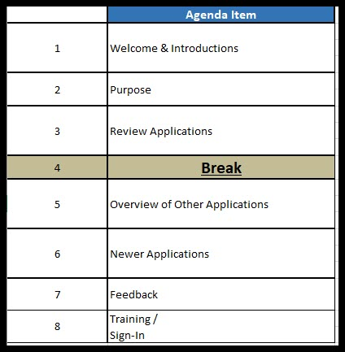

Slide 3
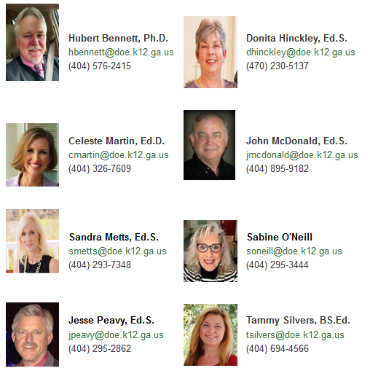
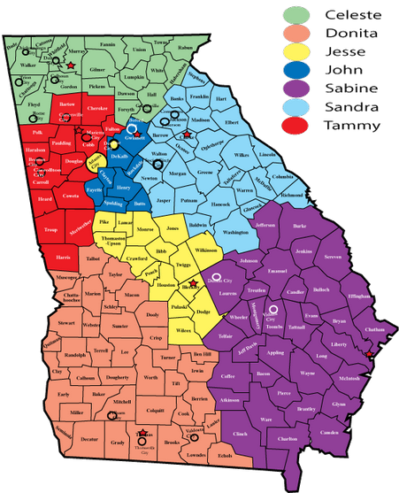
Trainers

Slide 4
Why Should we use SLDS

Slide 7
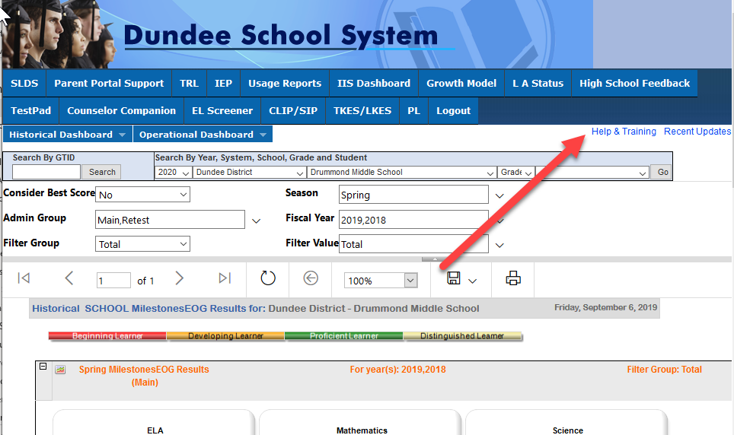

Slide 8
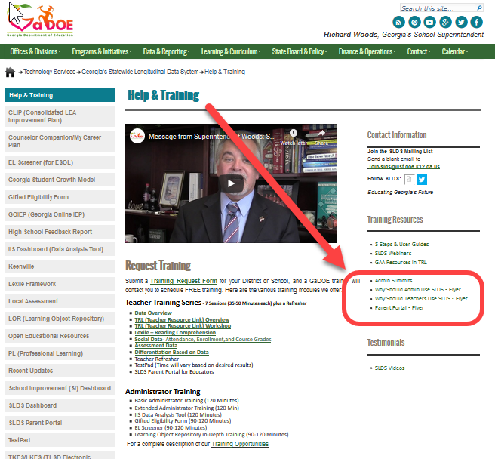

Slide 9
Purpose of Summits
Admin Summits are designed to share information on a broad range of information or topics. Ideally, after seeing the various applications in SLDS, it may prompt you to request training on the topics that you recognize as being most beneficial to you and your staff.

Slide 10
Poll Everywhere

Slide 12
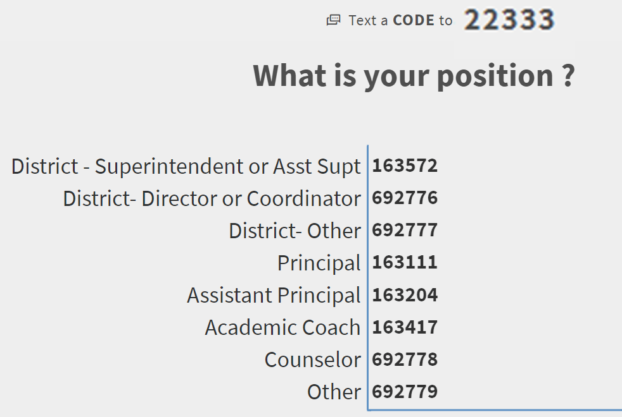

Slide 13
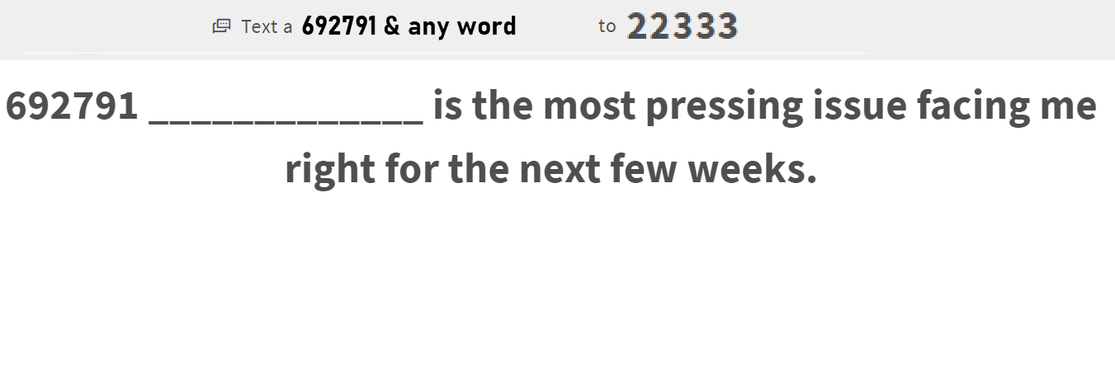

Slide 14
New Teacher Dashboard

Slide 15
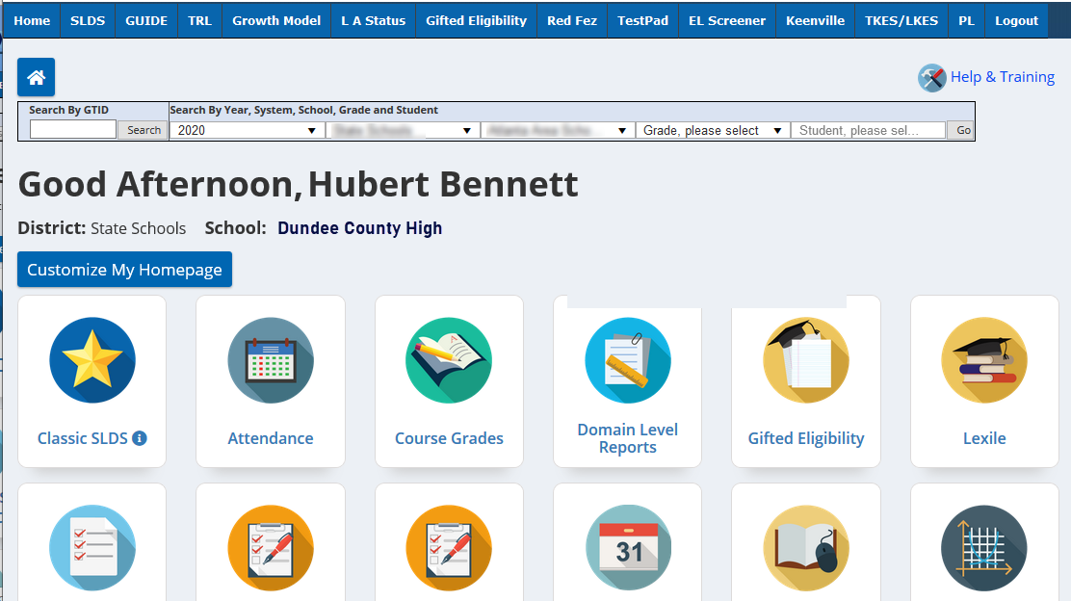

Slide 16
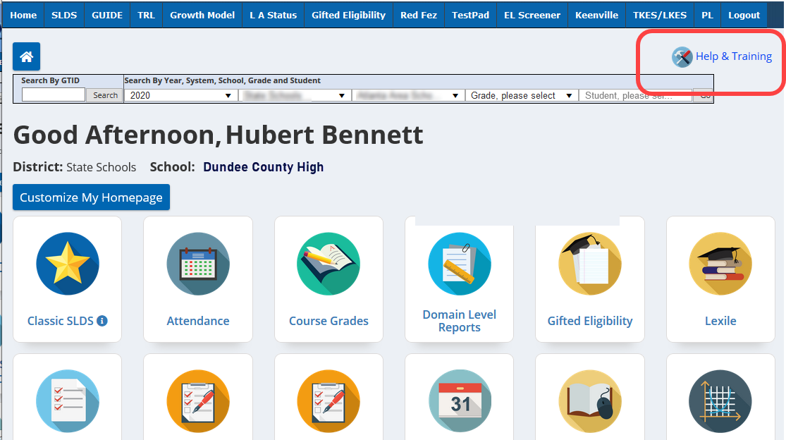

Slide 17
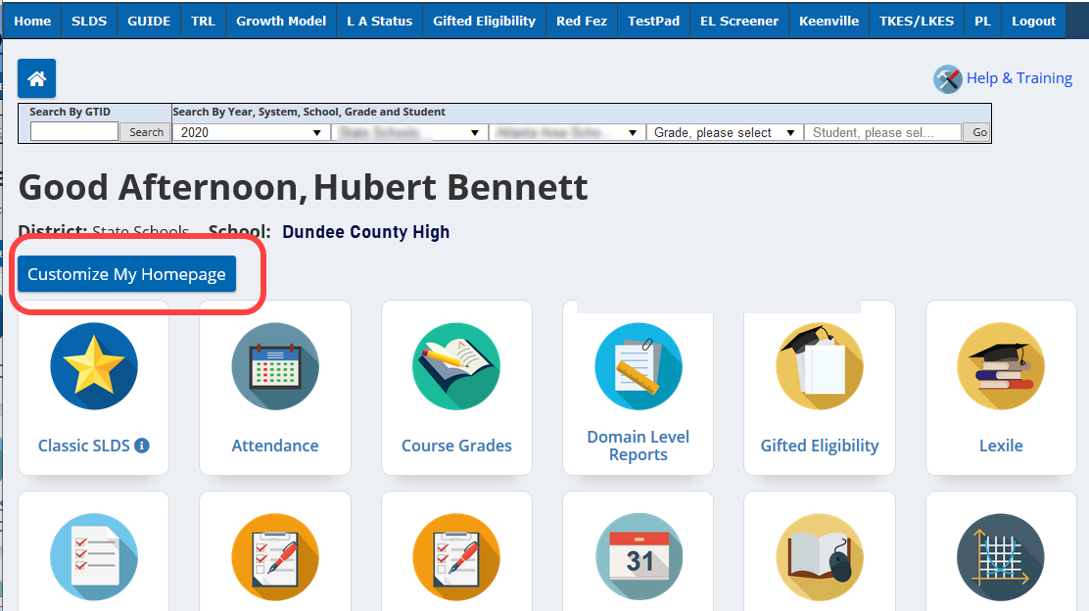

Slide 18
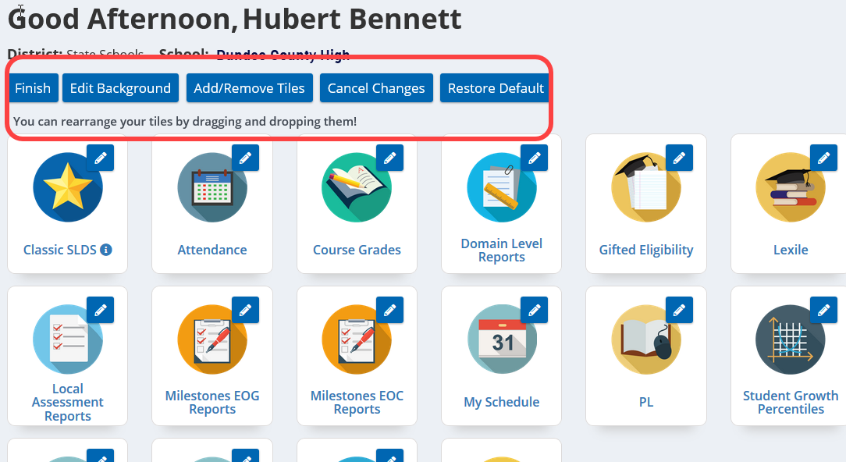

Slide 19
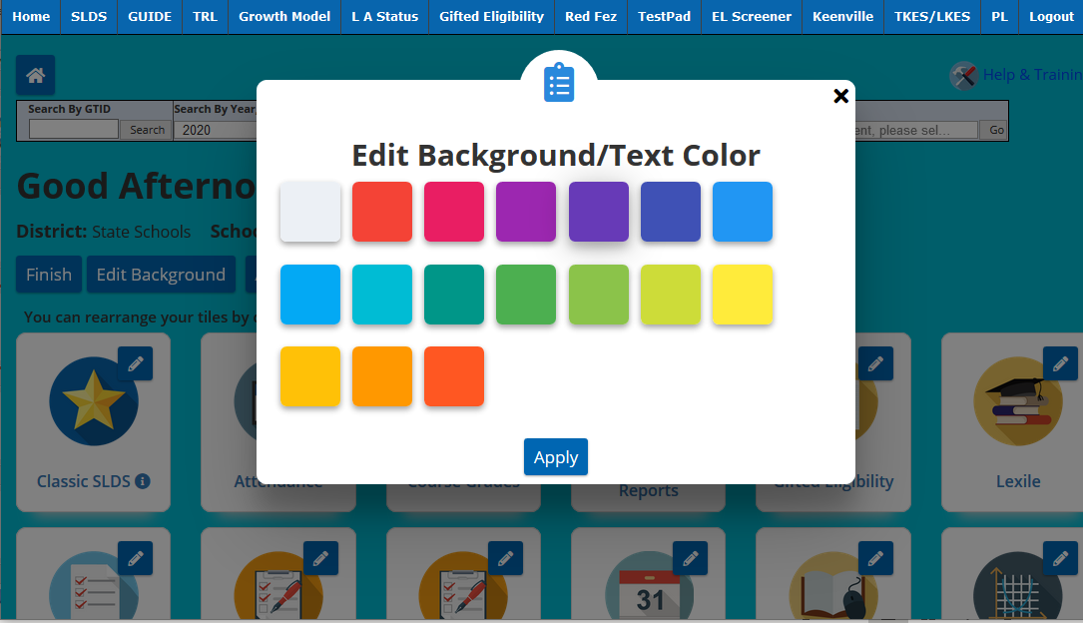

Slide 20
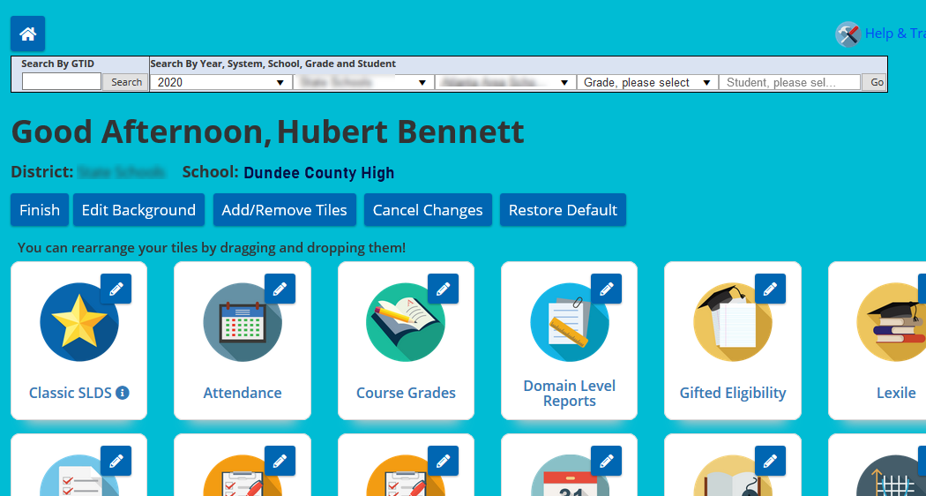

Slide 21
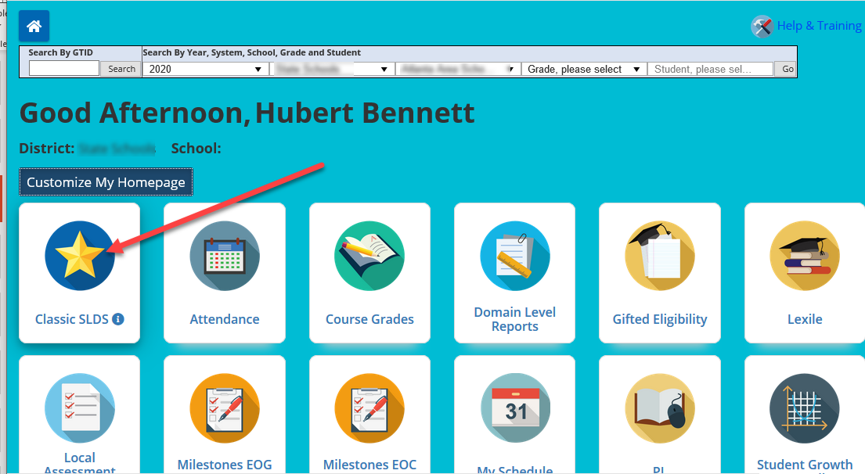

Slide 22
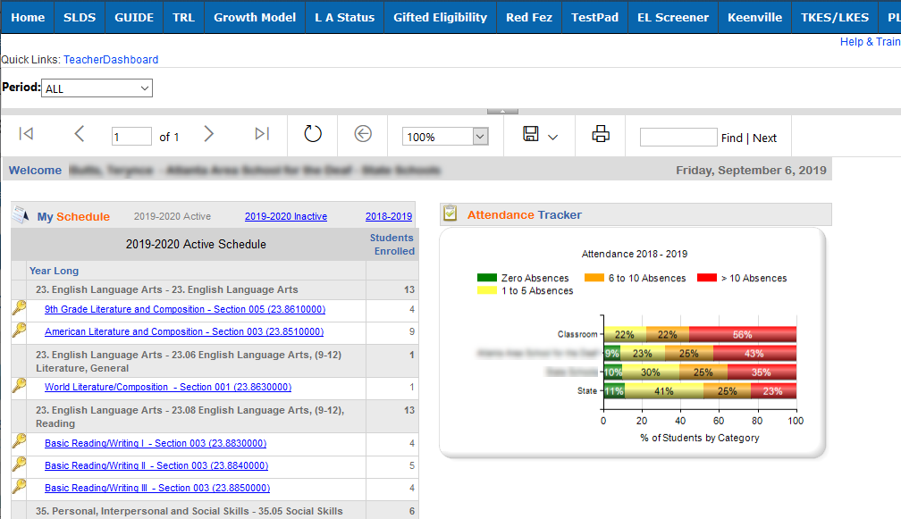

Slide 23
Student Profile Page

Slide 24
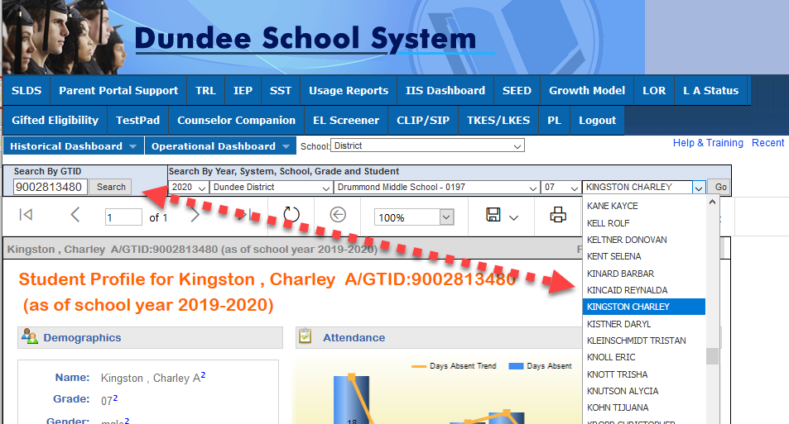

Slide 25
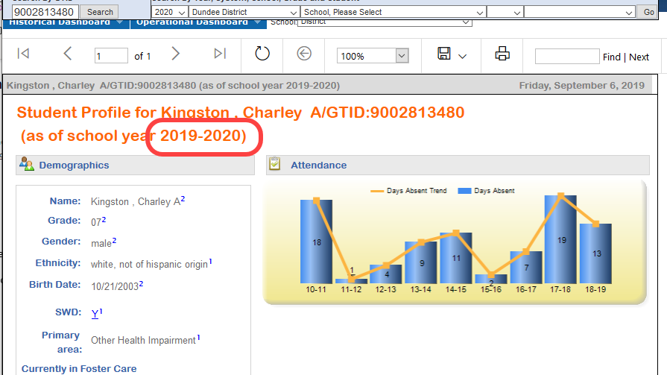

Slide 26
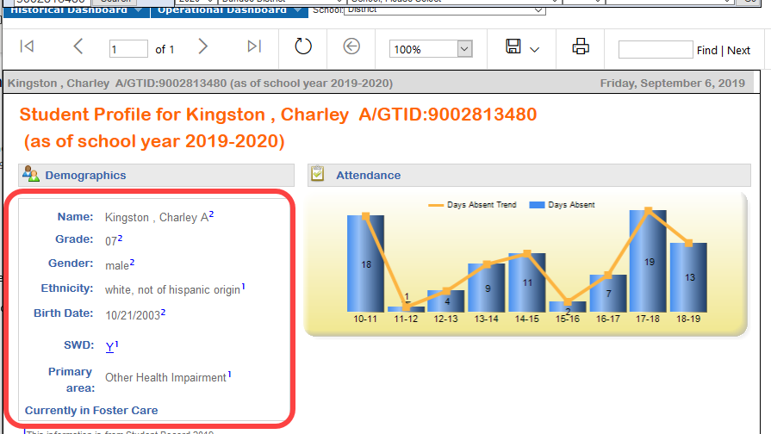

Slide 27
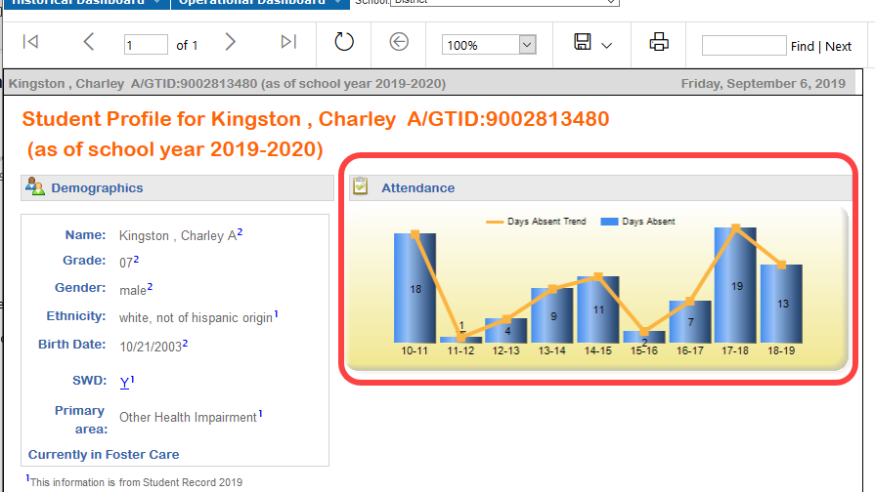

Slide 28
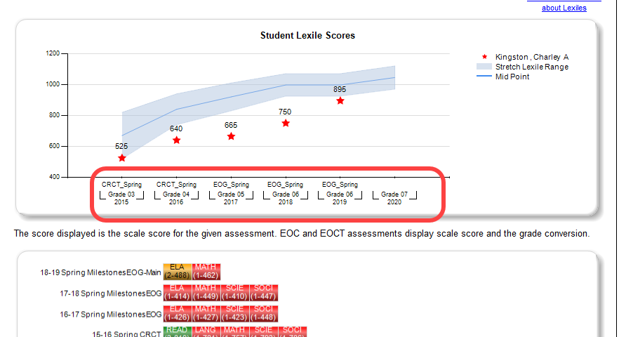

Slide 29
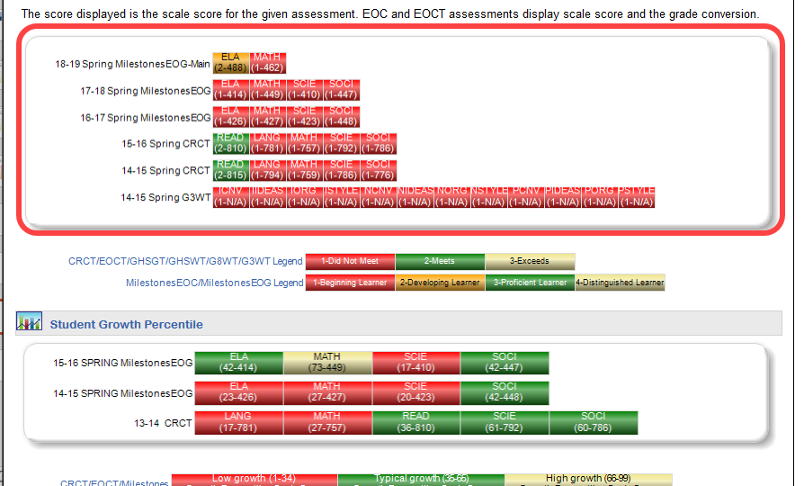

Slide 30
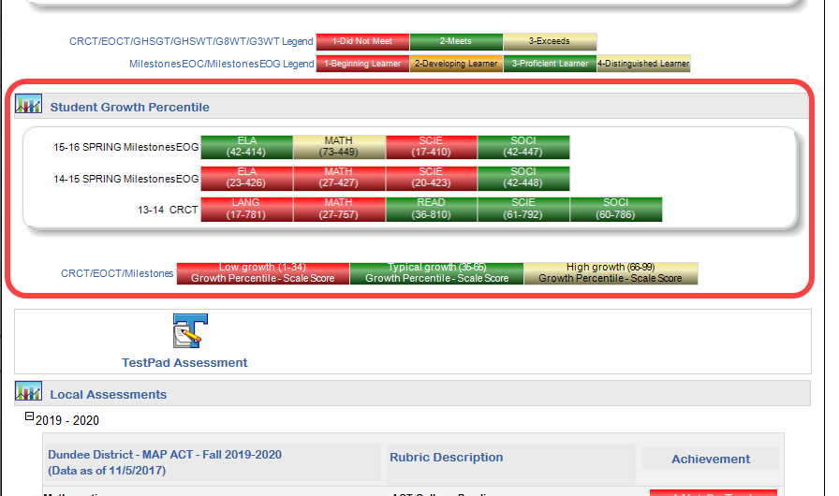

Slide 31
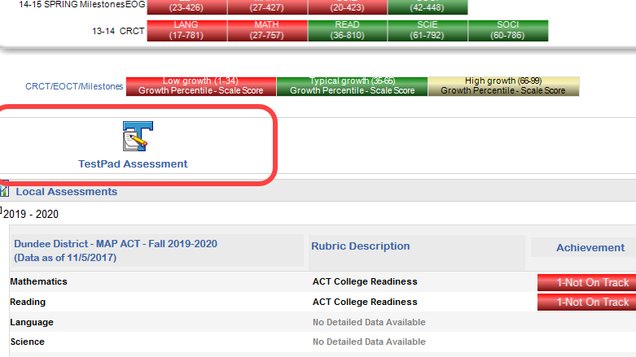

Slide 32
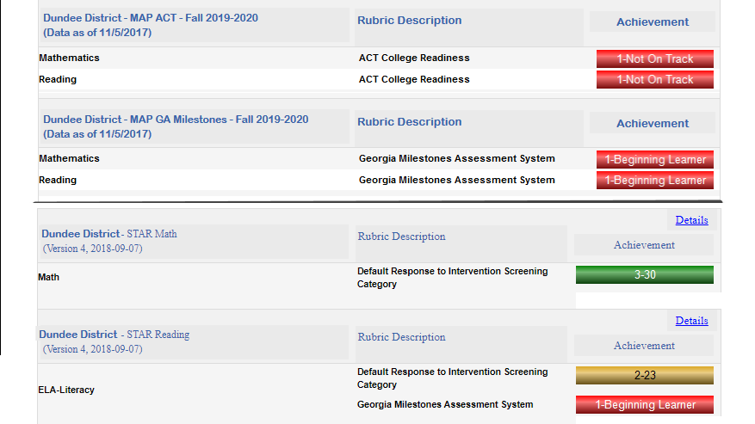

Slide 33
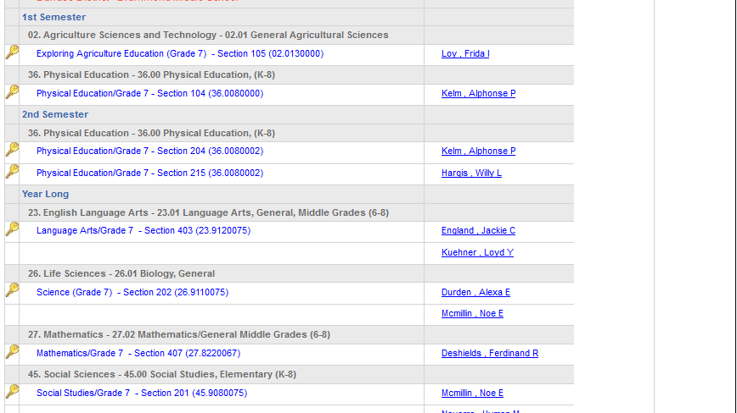

Slide 34
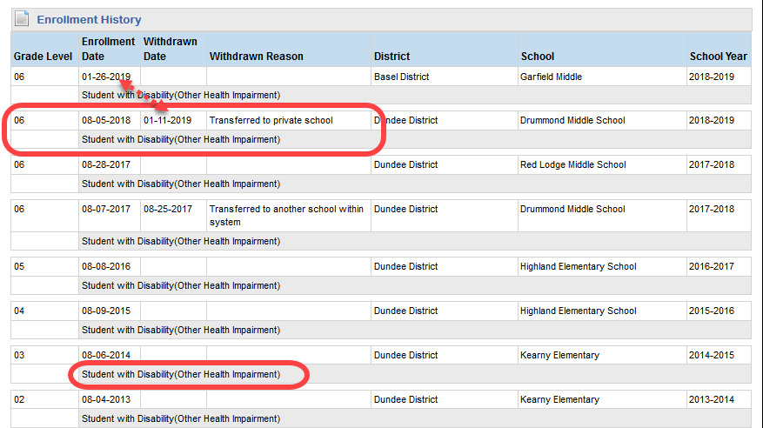

Slide 35
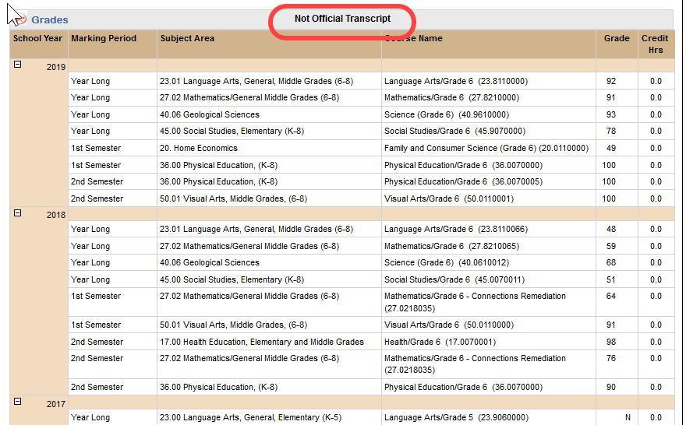

Slide 36
EL Screener

Slide 37
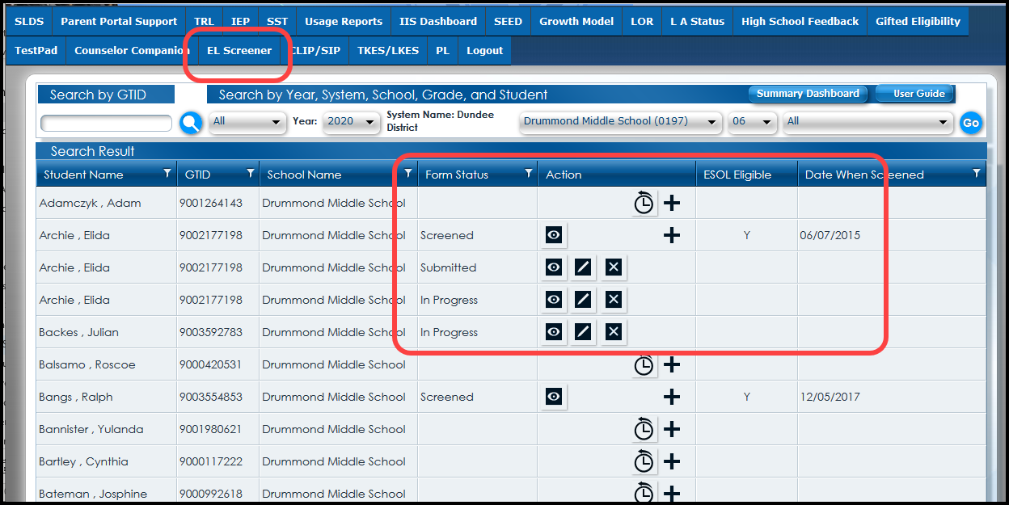

Slide 38
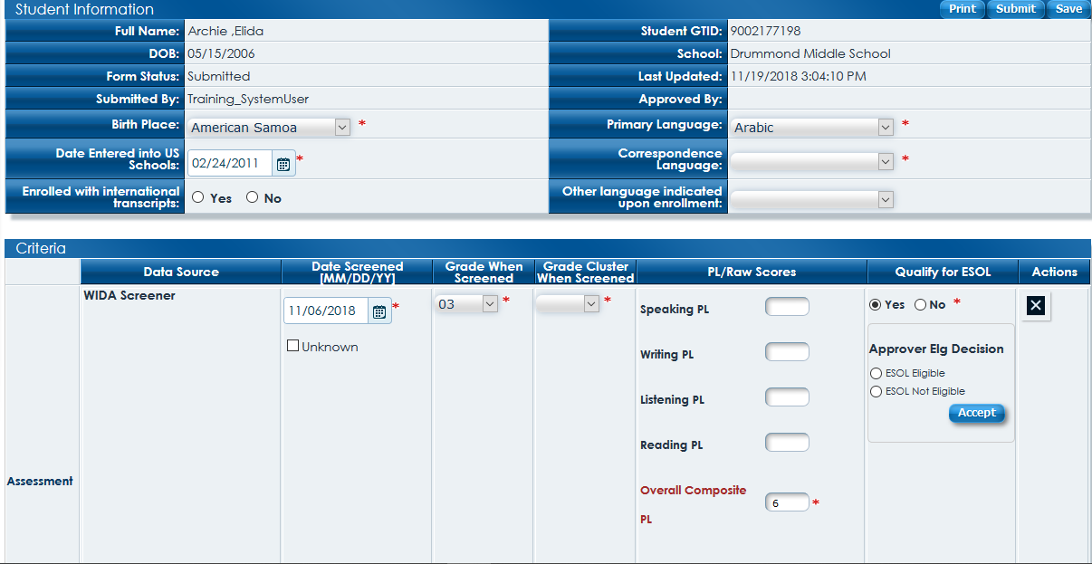

Slide 39
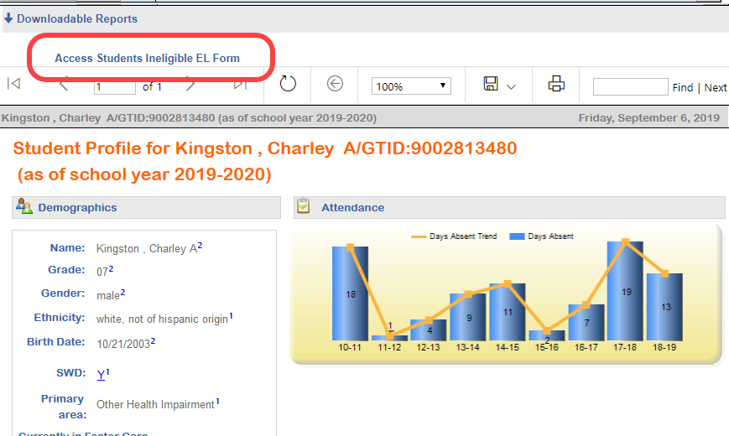

Slide 40
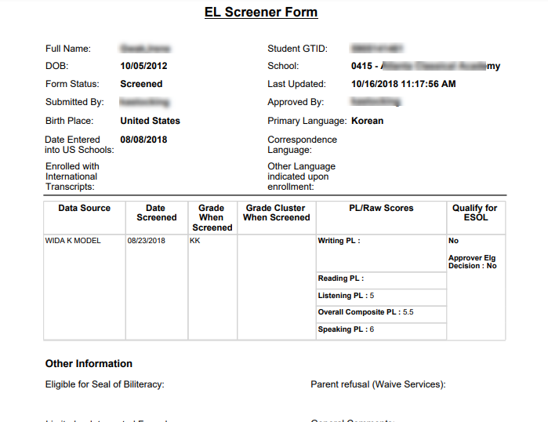

Slide 41
Gifted Eligibility

Slide 42
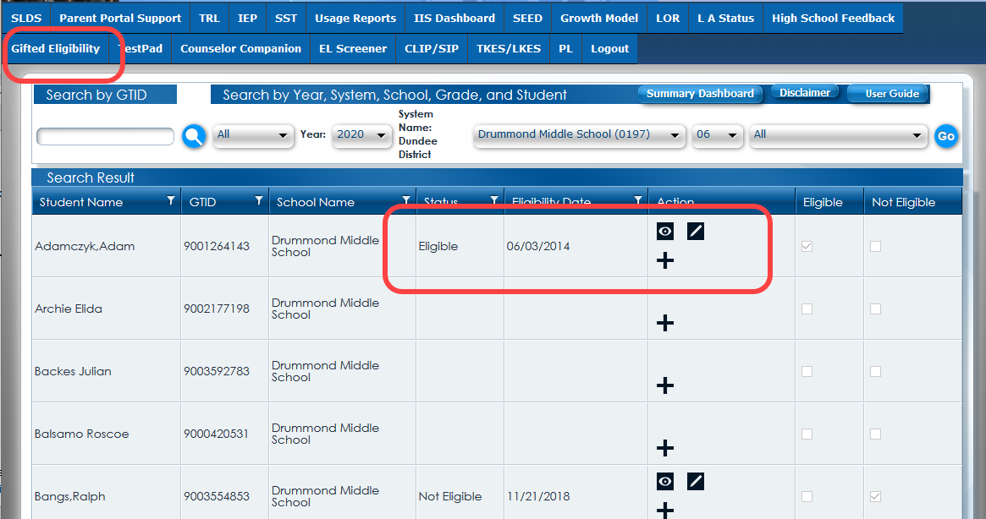

Slide 43
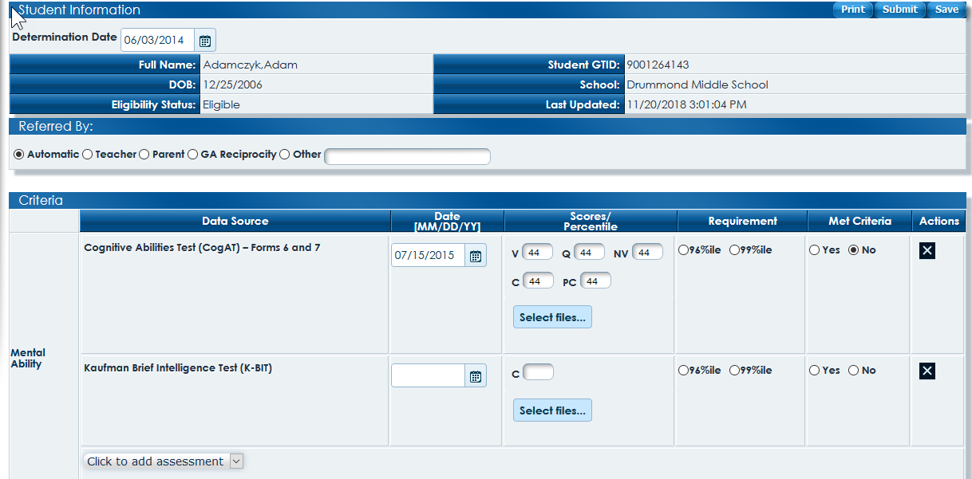

Slide 44
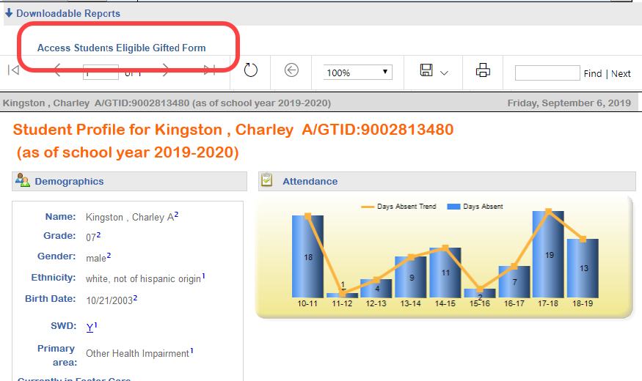

Slide 45
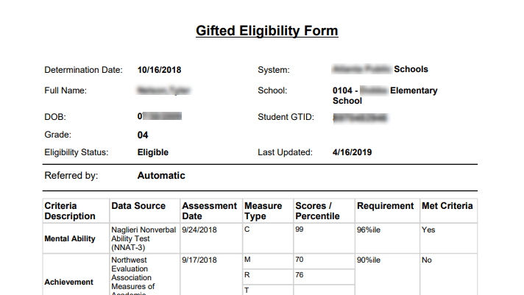

Slide 46
Parent Portal

Slide 48
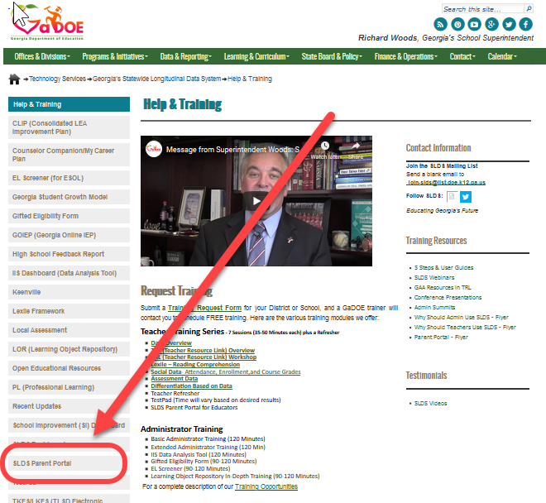

Slide 49
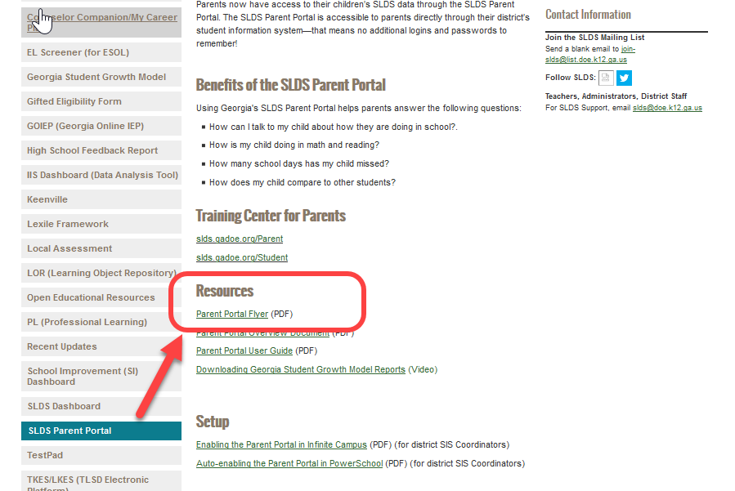

Slide 51
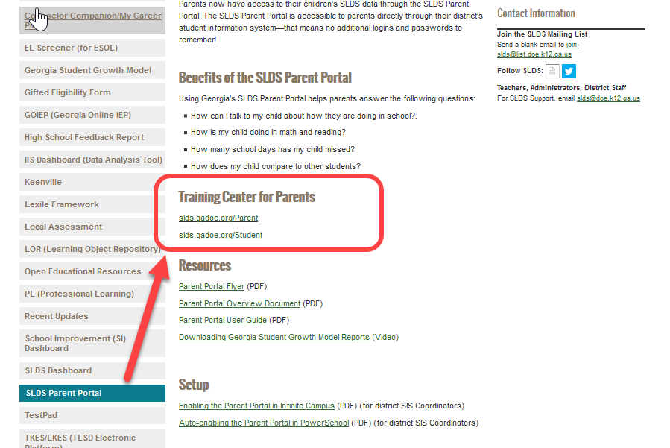

Slide 52
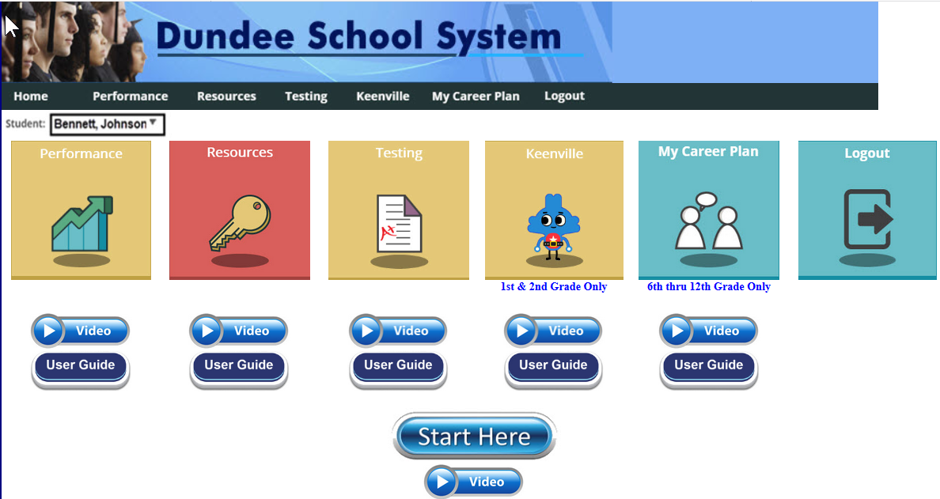

Slide 53
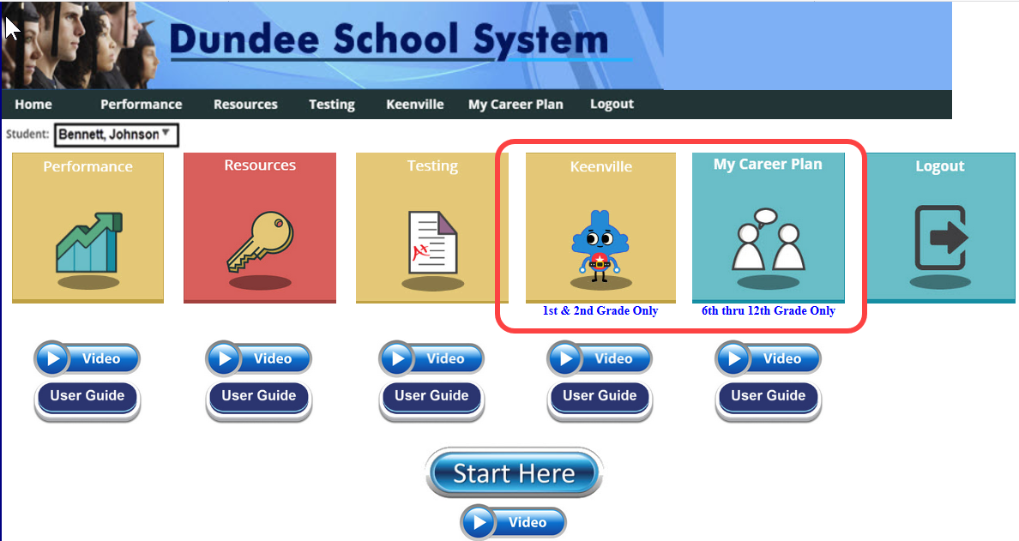

Slide 54
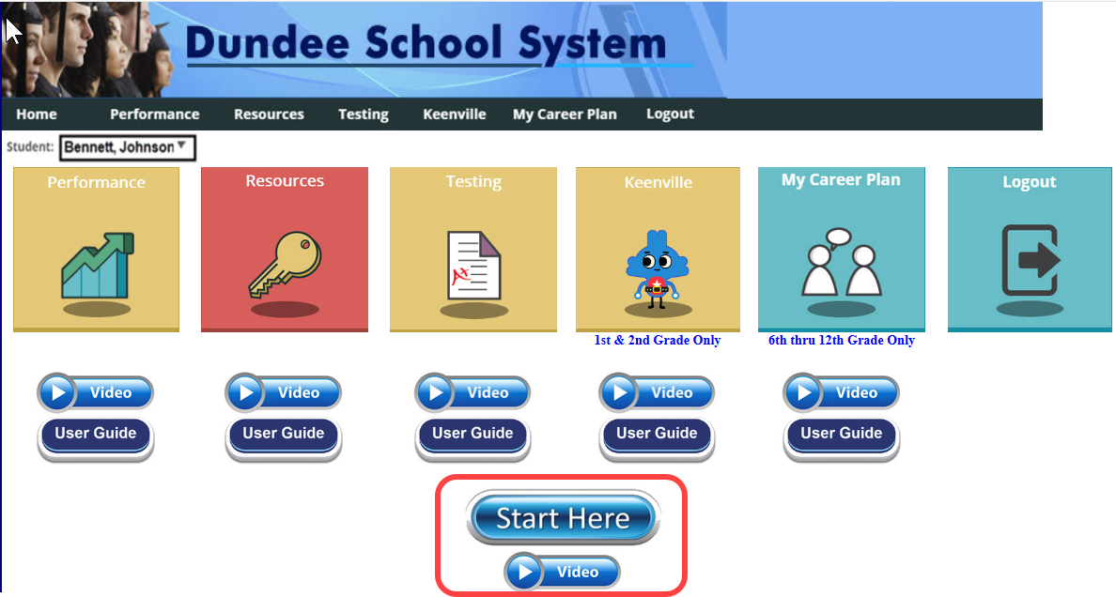

Slide 56
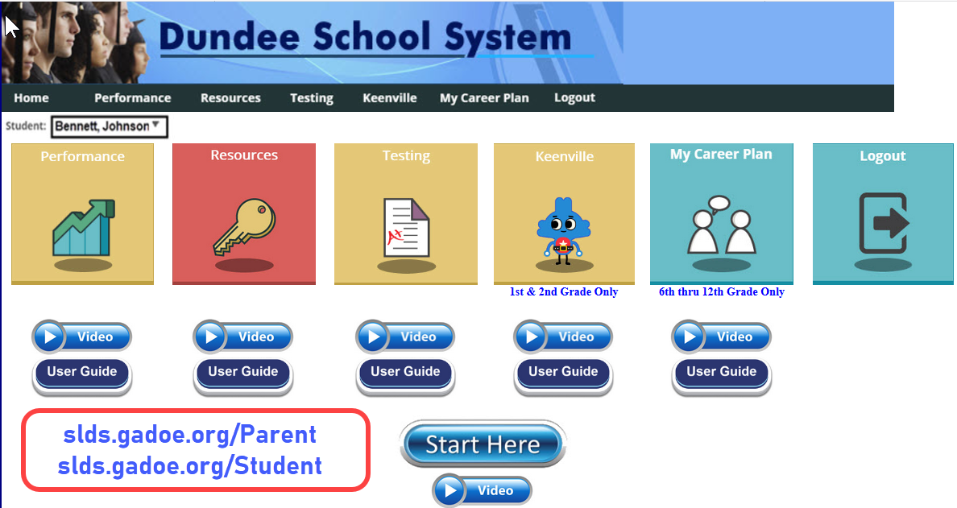

Slide 57
Parent Portal Support

Slide 58
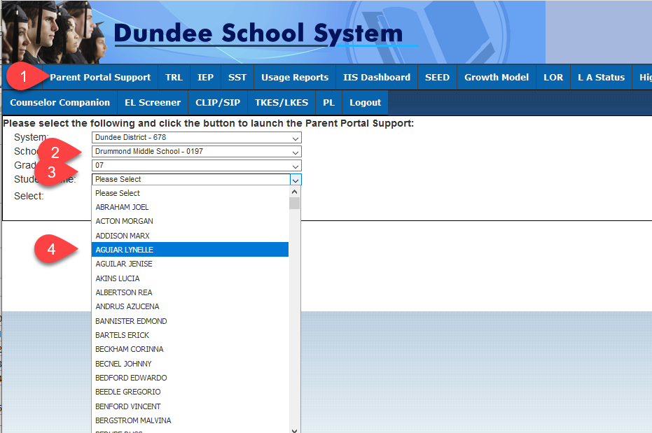

Slide 59
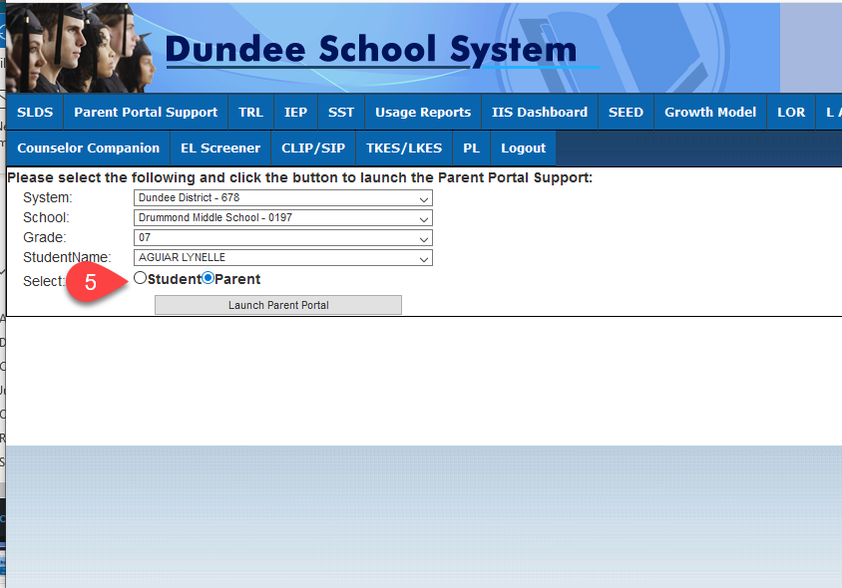

Slide 60
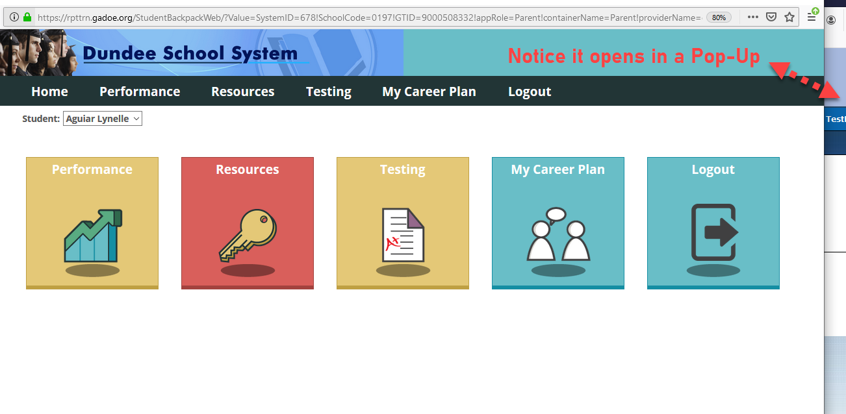

Slide 61
Counselor Companion

Slide 62
GCIC’s Ability Explorer will no longer be counted towards Aptitude module for 2020 fiscal year since it is not performance based. Students who have completed GCIC’s Ability Explorer or will complete GCIC’s Ability Explorer in the current 2020 fiscal year will not receive Aptitude credit. They will get credit towards Career Assessment only
Students who completed their GCIC’s Ability Explorer exercise last year in their required grade level still can keep Aptitude credit
The importance of timely student claims and rosters for students to access My Career Plan

Slide 63
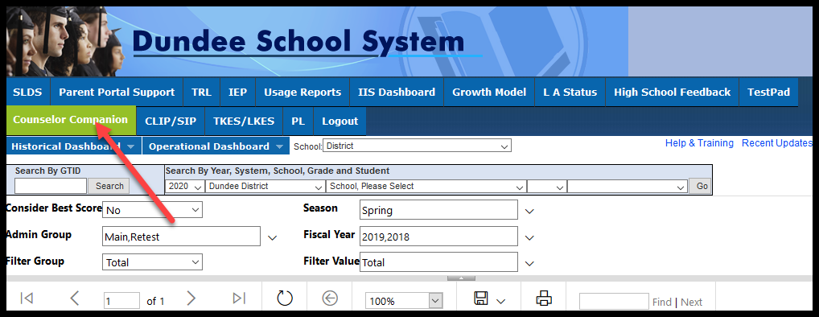

Slide 64
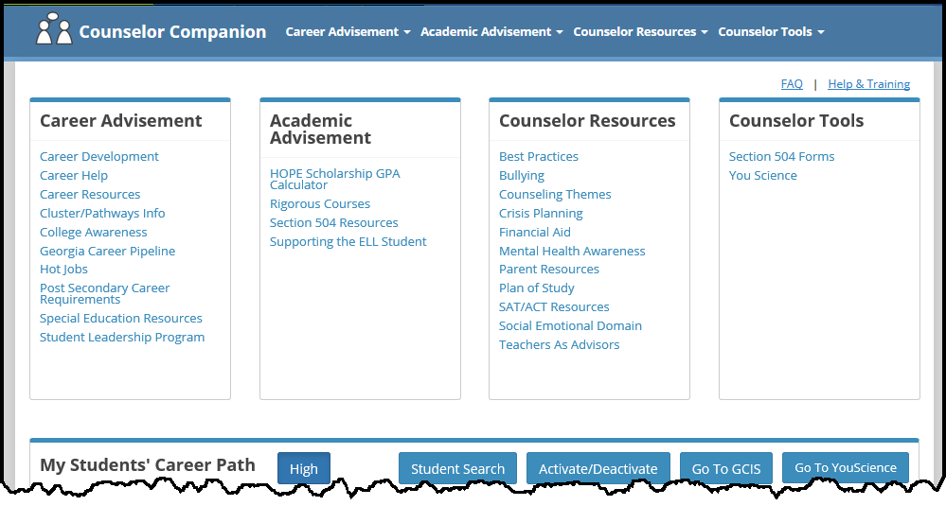

Slide 65
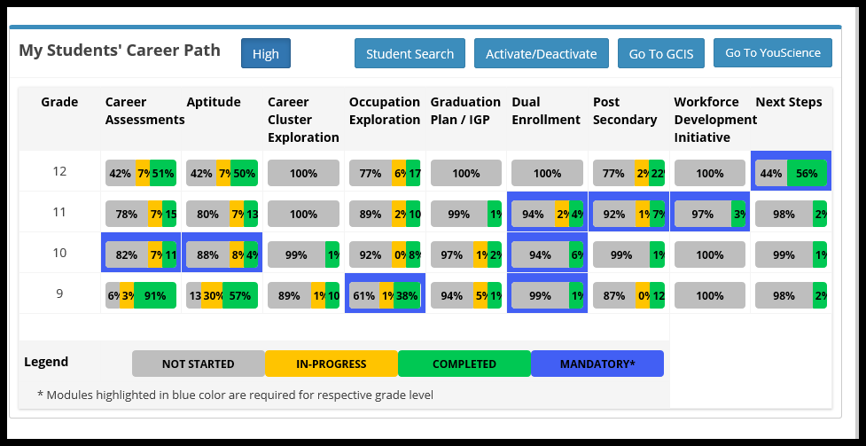

Slide 66
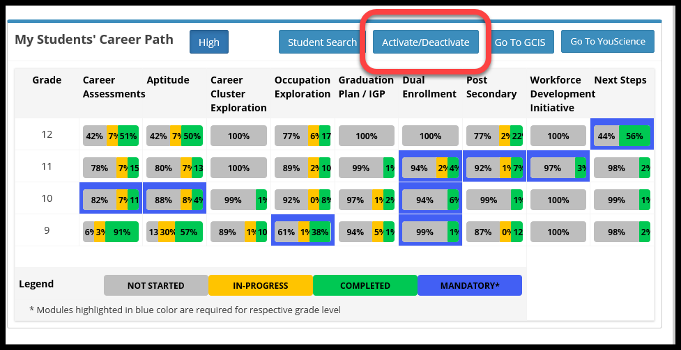

Slide 67
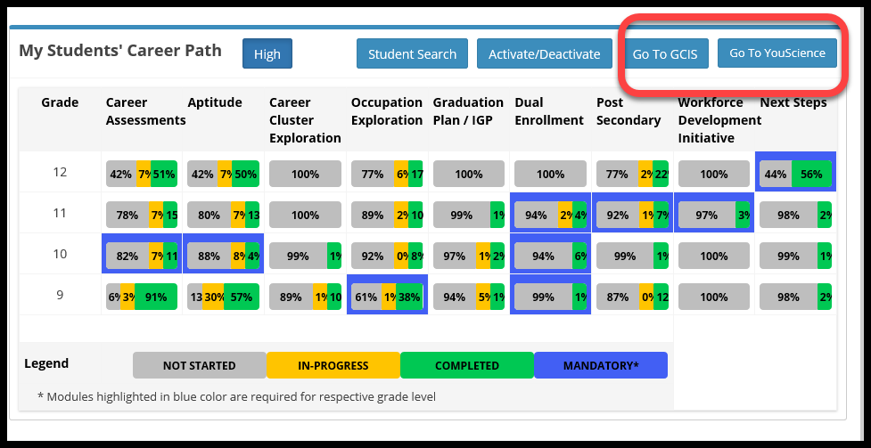

Slide 69
High School Feedback

Slide 74
Historical Vs Operational

Slide 76
Foster Kids

Slide 78
Student Profile Page

Slide 79
Operational –
Differentiation

Slide 89
How do you see what teachers can see?

Slide 98
The NEW way that teachers see this !

Slide 101
How can you use this for differentiation in your building?

Slide 102
Digital Resources

Slide 120
Districts can add Resources by using LOR

Slide 121
Formative (Local) Assessments

Slide 124
Renaissance Learning

Slide 128
Student Profile Page

Slide 129
MAP - Measure of Academic Progress

Slide 135
Student Profile Page

Slide 136
Keenville

Slide 142
TestPad

Slide 160
Discuss how formative assessments have/will assist your students to move forward.

Slide 161
SI Dashboard

Slide 170
CLIP/SIP

Slide 178
IIS Dashboard

Slide 190
Export to Excel

Slide 191
Export to CSV

Slide 193
Discussion: How would you group data for School Information?

Slide 194
ES4PS

Slide 199
https://www.gadoe.org/School-Improvement/Federal-Programs/Pages/Allocations_and_Proportionate_Share_Archive.aspx

Slide 200
PL (Professional Learning)

Slide 201
One way to get to PL – two other ways will be discussed later.

Slide 204
TKES/LKES

Slide 212
Request Services

Slide 220
PBIS

Slide 229
MTSS

Slide 231
Landing Page

Slide 232
Student Profile

Slide 233
Team Members

Slide 234
Student Support Team (SST) Meeting

Slide 235
State Assessments
Notes:
SST Tab 2

Slide 236
Student Data
Notes:
SST Tab 3
Replace screenshot

Slide 237
Progress Monitoring
Notes:
SST Tab 4 – Progress Monitoring

Slide 238
Documents

Slide 239
Questions, Comments, Suggestions

Slide 249
To get confirmation that you attended this session please complete the digital sign-in with QR code.
slds@doe.k12.ga.us
email
slds.gadoe.org/Help
website

